Slide 1
Protoctists Prokaryotes & Viruses
Wenting Chai

Slide 2
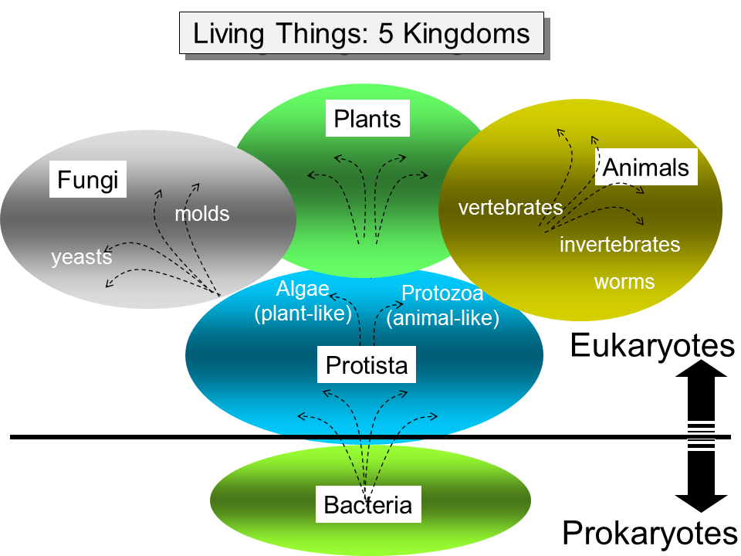

Slide 3
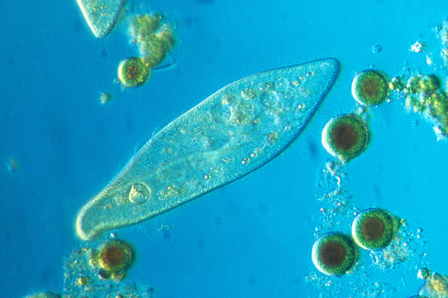
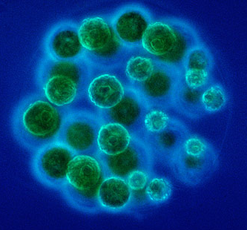
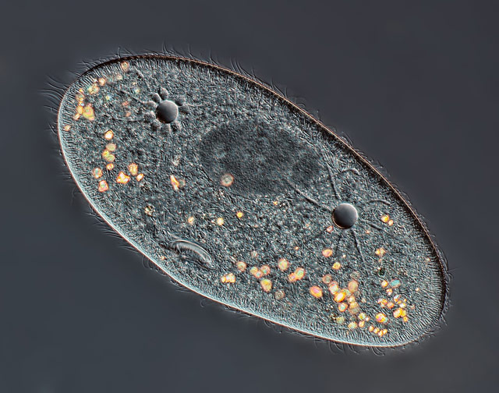
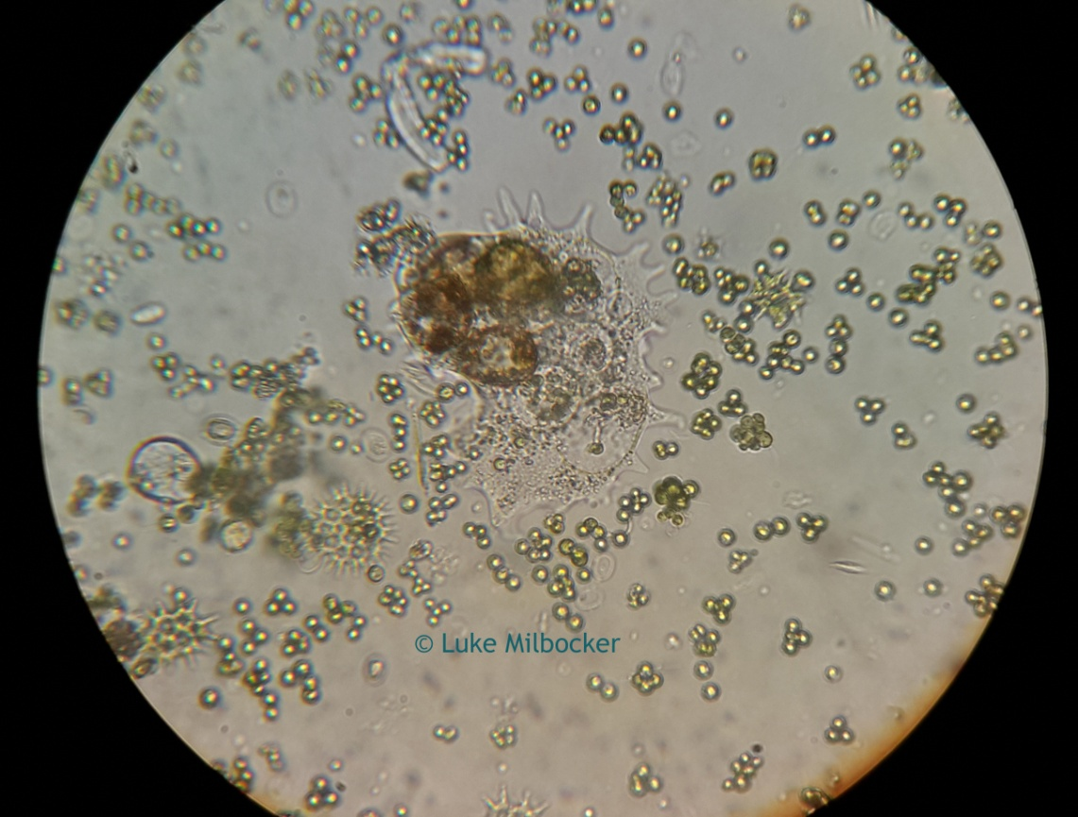
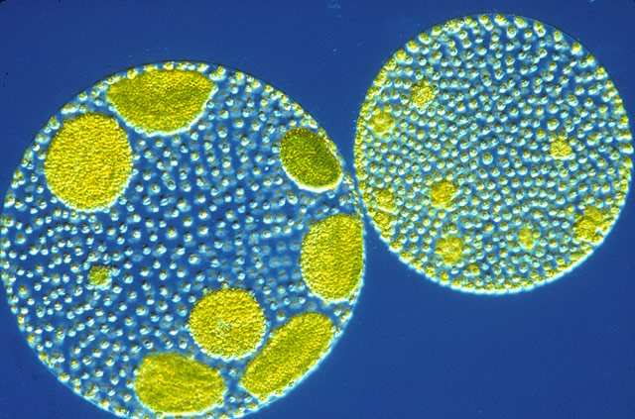
Protoctists
Paramecium
Amoeba
Volvox

Slide 4
Protoctists
Characteristics:
Mostly unicellular
Cells have a nucelus
Plant-like type protoctists have cell wall (NOT made of cellulose) and chloroplasts, but not the animal-like type
Plant-like type protoctists feed by photosynthesis but not the animal-like type
Plant-like protoctist
e.g. Amoeba
Paramecium
Animal-like protoctist
e.g. volvox
diatom
protoctist

Slide 5
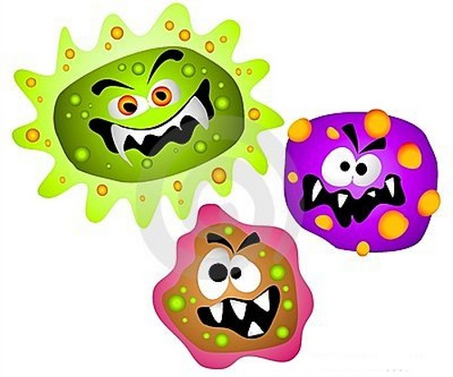
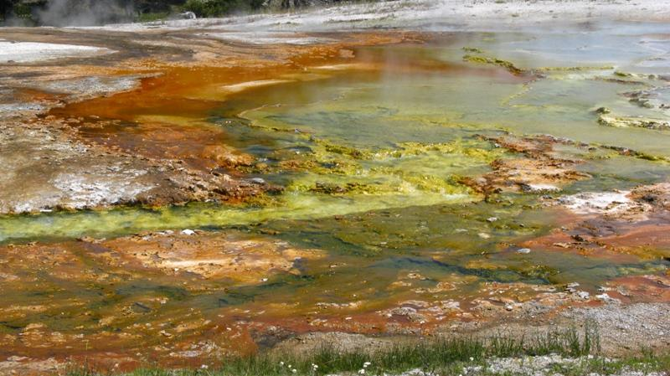
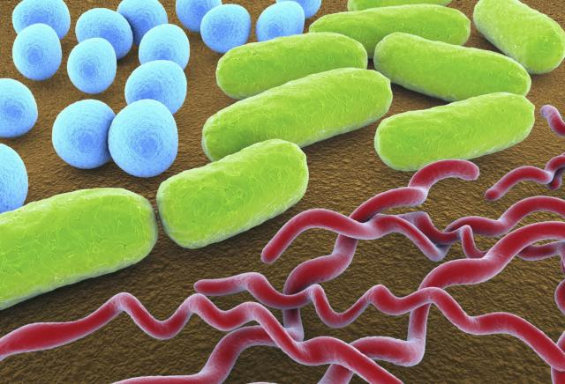
Prokaryotes
Shapes: rods, spheres and spirals

Slide 6
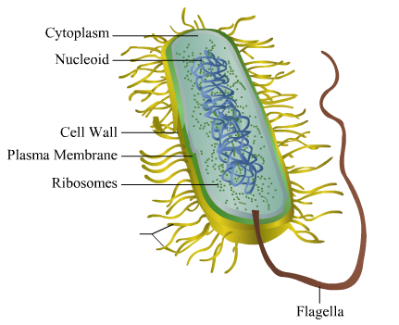
Prokaryotes
Characteristics:
Often unicellular
Have no nucleus
Have cell walls (not made of cellulose)
Have no membrane-bound organelles such as mitochondria, ER and chloroplast
plasmid

Slide 7

Prokaryotes
Q: What is a plasmid in bacteria?
A: They are most commonly found as small circular, double-stranded DNA molecules in bacteria.
While chromosomes (DNA) are large and contain all the essential genetic information for living under normal conditions, plasmids are usually very small and contain only additional genes that may be useful in certain situations or conditions.

Slide 8
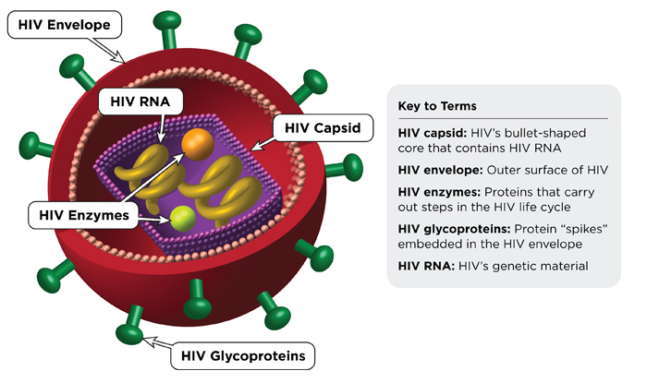
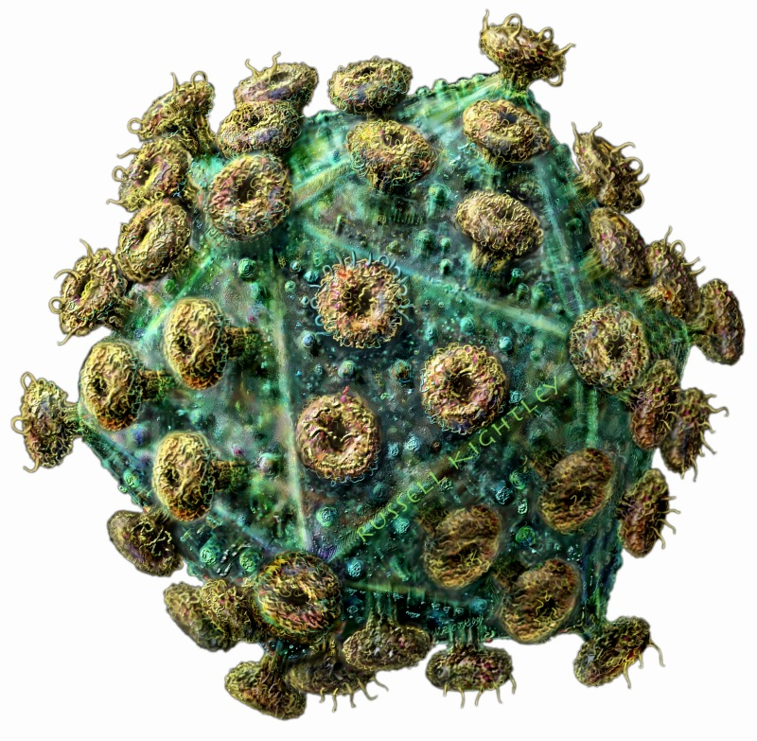
Virus

Slide 9
